Slide 1
Java Script Object Notation (JSON)
Bernardo Nugroho Yahya

Slide 2
Contents
JavaScript Object Notation (JSON) Introduction
JSON Examples

Slide 3
JSON example
“JSON” stands for “JavaScript Object Notation”
Despite the name, JSON is a (mostly) language-independent way of specifying objects as name-value pairs
JSON is a syntax for passing around objects that contain name/value pairs, arrays and other objects.
Example (http://secretgeek.net/json_3mins.asp):
{"skillz": { "web":[ { "name": "html", "years": 5 }, { "name": "css", "years": 3 }] "database":[ { "name": "sql", "years": 7 }] }}

Slide 4
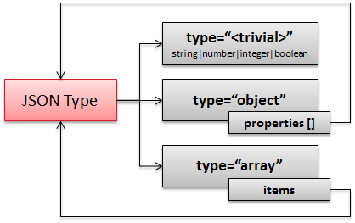
JSON Schema

Slide 5
JSON syntax, I
An object is an unordered set of name/value pairs
The pairs are enclosed within braces, { }
There is a colon between the name and the value
Pairs are separated by commas
Example: { "name": "html", "years": 5 }
An array is an ordered collection of values
The values are enclosed within brackets, [ ]
Values are separated by commas
Example: [ "html", ”xml", "css" ]

Slide 6
JSON syntax, II
A value can be: A string, a number, true, false, null, an object, or an array
Values can be nested
Strings are enclosed in double quotes, and can contain the usual assortment of escaped characters
Numbers have the usual C/C++/Java syntax, including exponential (E) notation
All numbers are decimal--no octal or hexadecimal
Whitespace can be used between any pair of tokens

Slide 7
eval
The JavaScript eval(string) method compiles and executes the given string
The string can be an expression, a statement, or a sequence of statements
Expressions can include variables and object properties
eval returns the value of the last expression evaluated
When applied to JSON, eval returns the described object

Slide 8
JSON and—methods?
In addition to instance variables, objects typically have methods
There is nothing in the JSON specification about methods
However, a method can be represented as a string, and (when received by the client) evaluated with eval
Obviously, this breaks language-independence
Also, JavaScript is rarely used on the server side

Slide 9
Comparison of JSON and XML
Similarities:
Both are human readable
Both have very simple syntax
Both are hierarchical
Both are language independent
Both can be used by Ajax
Differences:
Syntax is different
JSON is less verbose
JSON can be parsed by JavaScript’s eval method
JSON includes arrays
Names in JSON must not be JavaScript reserved words
XML can be validated
JavaScript is not typically used on the server side

Slide 10
Namespace
http://www.w3c.org/TR/REC-xml-names/
In this example, there are three occurrences of the name title within the markup, and the name alone clearly provides insufficient information to allow correct processing by a software module.
<section>
<title>Book-Signing Event</title>
<signing>
<author title="Mr" name="Vikram Seth" />
<book title="A Suitable Boy" price="$22.95" />
</signing>
<signing>
<author title="Dr" name="Oliver Sacks" />
<book title="The Island of the Color-Blind"
price="$12.95" />
</signing>
</section>

Slide 11
Namespace
{"section":
"title": "Book-Signing Event",
"signing": [
{
"author": { "title": "Mr", "name": "Vikram Seth" },
"book": { "title": "A Suitable Boy",
"price": "$22.95" }
}, {
"author": { "title": "Dr", "name": "Oliver Sacks" },
"book": { "title": "The Island of the Color-Blind",
"price": "$12.95" }
}
]
}}
section.title
section.signing[0].author.title
section.signing[1].book.title

Slide 12
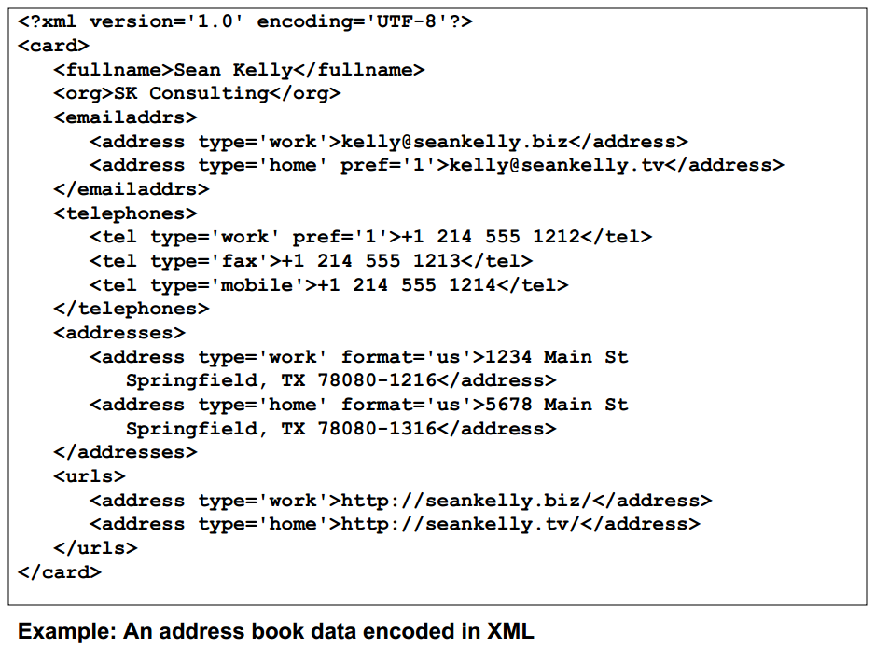

Slide 13
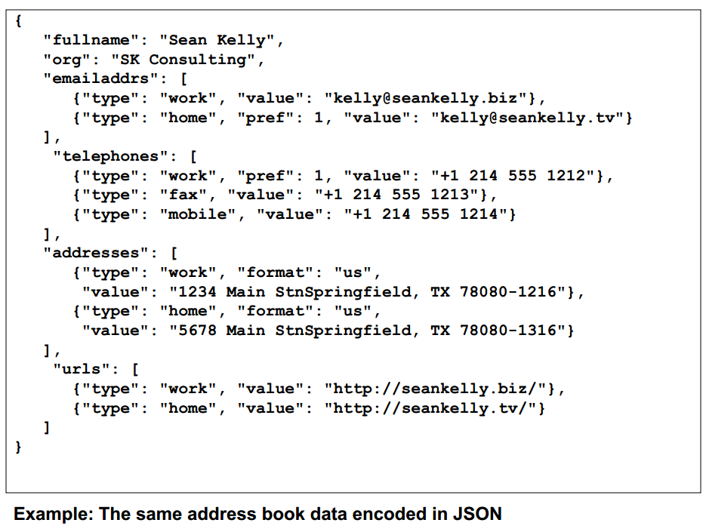

Slide 14
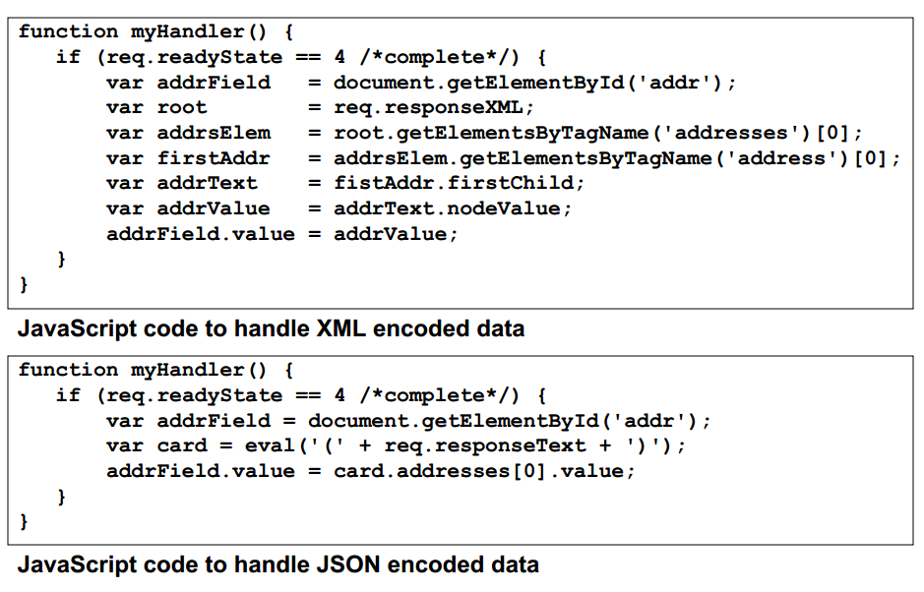

Slide 15
Let‘s try the example
First, download a jar file.
For this example, please download a jar file from this link
https://code.google.com/p/json-simple/
The file name: json-simple-1.1.1.jar
Copy the file into the workspace (for the convenience)

Slide 16
In Eclipse
In your project, press the right click button of your mouse and choose “Build Path” → “Configure Build Path” → Add jar → choose the folder which you put the jar file → OK

Slide 17
1st Example
The 1st example shows how to write a JSON-based data

Slide 18
JsonSimple.java
package json;
import java.io.FileWriter;
import java.io.IOException;
import org.json.simple.JSONArray;
import org.json.simple.JSONObject;
public class JsonSimple {
public static void main(String[] args) {
JSONObject obj = new JSONObject();
obj.put("skills", "programming");
obj.put("age", new Integer(40));
JSONArray list1 = new JSONArray();
list1.add("HTML");
list1.add("XML");
obj.put("web", list1);
JSONArray list2 = new JSONArray();
list2.add("Java");
list2.add("C");
obj.put("desktop", list2);
try {
FileWriter file = new FileWriter("test.json");
file.write(obj.toJSONString());
file.flush();
file.close();
} catch (IOException e) {
e.printStackTrace();
}
System.out.print(obj);
}
}

Slide 19
2nd Example
The 2nd example shows how to read a JSON data

Slide 20
JsonRead.java
package json;
import java.io.FileNotFoundException;
import java.io.FileReader;
import java.io.IOException;
import java.util.Iterator;
import org.json.simple.JSONArray;
import org.json.simple.JSONObject;
import org.json.simple.parser.JSONParser;
import org.json.simple.parser.ParseException;
public class JsonRead {
public static void main(String[] args) {
JSONParser parser = new JSONParser();
try {
Object obj = parser.parse(new FileReader("test.json"));
JSONObject jsonObject = (JSONObject) obj;
String name = (String) jsonObject.get("skills");
System.out.println("skills :"+name);
long age = (Long) jsonObject.get("age");
System.out.println("age: "+age);
// loop array
JSONArray msg = (JSONArray) jsonObject.get("desktop");
Iterator<String> iterator = msg.iterator();
while (iterator.hasNext()) {
System.out.println("programming language: "+iterator.next());
}
// loop 2nd array
msg = (JSONArray) jsonObject.get("web");
iterator = msg.iterator();
while (iterator.hasNext()) {
System.out.println("web language:"+iterator.next());
}
} catch (FileNotFoundException e) {
e.printStackTrace();
} catch (IOException e) {
e.printStackTrace();
} catch (ParseException e) {
e.printStackTrace();
}
}
}

Slide 21
Application with Graph
First, we need to provide the data. For this purpose, we will use sample.json
Second, we need to write the JSP with the inclusion of JSON data to show the result

Slide 22
JSON Data
It is about Pizza Topping with two attributes:
Attribute name : represent the topping name
Attribute amount : represent the quantity
The data is created in JSON format

Slide 23
sample.json
{
"cols": [
{"id":"","label":"Topping","type":"string"},
{"id":"","label":"Slices","type":"number"}
],
"rows": [
{"c":[{"v":"Mushrooms"},{"v":3}]},
{"c":[{"v":"Onions"},{"v":1}]},
{"c":[{"v":"Olives"},{"v":1}]},
{"c":[{"v":"Zucchini"},{"v":1}]},
{"c":[{"v":"Pepperoni"},{"v":2}]}
]
}

Slide 24
JSP View
In order to view the data in a chart (this example utilizes Pie Chart using Google Chart API), we need to do the following steps
Load Visualization API
Set a callback to run when the Google Visualization API is loaded
Retrieve the data
Create data table out of JSON data loaded from server
Instantiate and draw Chart

Slide 25
example.jsp
<%@ page language="java" contentType="text/html; charset=EUC-KR"
pageEncoding="EUC-KR"%>
<html>
<head>
<!--Load the AJAX API-->
<script type="text/javascript" src="https://www.gstatic.com/charts/loader.js"></script>
<script type="text/javascript" src="//ajax.googleapis.com/ajax/libs/jquery/1.10.2/jquery.min.js"></script>
<script type="text/javascript">
// Load the Visualization API and the piechart package.
google.charts.load('current', {'packages':['corechart']});
// Set a callback to run when the Google Visualization API is loaded.
google.charts.setOnLoadCallback(drawChart);
function drawChart() {
var jsonData = $.ajax({
url: "sample.json",
dataType: "json",
async: false
}).responseText;
// Create our data table out of JSON data loaded from server.
var data = new google.visualization.DataTable(jsonData);
// Instantiate and draw our chart, passing in some options.
var chart = new google.visualization.PieChart(document.getElementById('chart_div'));
chart.draw(data, {width: 400, height: 240});
}
</script>
</head>
<body>
<!--Div that will hold the pie chart-->
<div id="chart_div"></div>
</body>
</html>

Slide 26
Summary
JSON is one of alternatives to store data
JSON has become a prominent data format in recent years in comparison with XML
JSON connects to most prominent visualization such as Google Chart

Slide 27
References
http://www.mkyong.com/java/json-simple-example-read-and-write-json/
http://code.google.com/p/json-simple/downloads/detail?name=json-simple-1.1.1.jar
http://www.cse.cuhk.edu.hk/~cjyuan/csc2720/slides/json.pdf

